Slide 1
Using DSL to plug-in your existing scripts
Urvashi Singh | Lead Architect usingh@electric-cloud.com

Slide 2
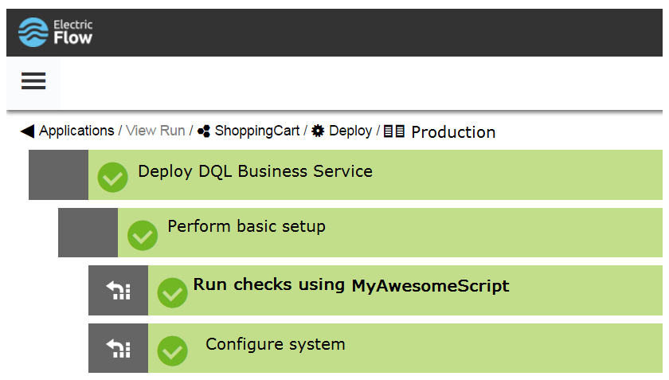
Objective
Incorporate your existing automation scripts into the application delivery pipeline

Slide 3
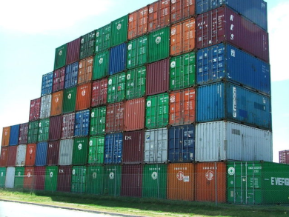

Requirements
Leverage scripts you already use
Package and deploy scripts with no special setup

Slide 4
Solution
Build a plugin using DSL that wraps your existing script

Slide 5
Why DSL
ElectricFlow DSL is an intuitive, and easy to use domain specific language that allows us to model continuous delivery and application release automation
procedure 'Perform System Checks', {
step 'runChecks',
command: new File(pluginDir, 'dsl/procedures/Perform System Checks/runChecks.groovy').text,
shell: 'ec-groovy'
}

Slide 6

Why Plugins
ElectricFlow plugins allow you to plug-in the tools you already use as part of your software delivery process, to add a layer of automation and governance to your tool chain.
Portability and easy deployment Versioning support

Slide 7
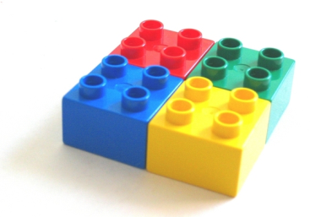
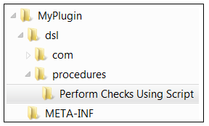
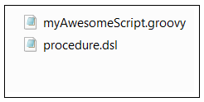
Plugin Wizard
https://github.com/electric-cloud/PluginWizard
Your plugin structure

Slide 8
Building the plugin
The procedure DSL
procedure 'Perform Checks Using Script', {
step 'runChecks',
command: new File(pluginDir, 'dsl/procedures/Perform Checks Using Script /yourAwesomeScript').text
}

Slide 9
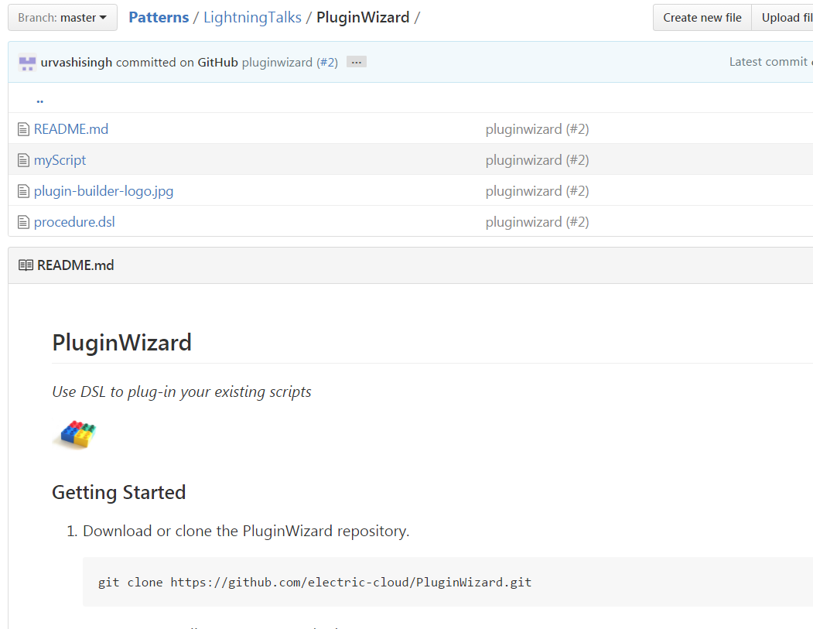
Checkout the Github page for code samples
https://github.com/electric-cloud/Patterns/tree/master/LightningTalks/PluginWizard

Slide 10
In summary
DSL with plugins make it easy to
leverage external tools and scripts as part of ElectricFlow’s release orchestration and automation processes
Allow you to get started quickly with building your own plugin (BYOP)

Slide 11
Additional Resources
Using DSL to plug-in your scripts
https://github.com/electric-cloud/Patterns/tree/master/LightningTalks/PluginWizard
Getting started with plugins using Plugin Wizard
https://github.com/electric-cloud/PluginWizard
Webinar: Get Started with ElectricFlow DSL in 1 Hour!
http://electric-cloud.com/blog/2016/03/getting-groovy-with-it-get-started-with-electricflow-dsl-in-1-hour
ElectricFlow DSL documentation
http://docs.electric-cloud.com/eflow_doc/7_0/API/HTML/APIflowHTML.htm#dsl/dslabout.htm

